Slide 1

Introduction to GitHub

Slide 2
Introduction to GitHub
GitHub is a powerful platform for version control, collaboration and an excellent place to store code!
This tutorial will guide you through the basics of using GitHub to manage your code, including creating repositories, committing changes, and pushing updates.
Before we start →
You should:
Have git installed locally (Installed by default on most Macs & Linux)
Have a GitHub account
Be able to connect to GitHub from your machine via SSH
Commands to set up SSH can be found here

Slide 3
Some basic terms to be familiar with:
Repository → A repository or (repo) is a storage location for your code and its version history. It contains all project files and their version history, allowing for collaboration and tracking changes over time.
Commit → A commit is a snapshot of the changes made to files in a repo. Each commit includes a unique identifier and message describing the changes.
Push → Pushing means uploading local repository changes to a remote repository on GitHub, making them available to others.
Clone → Cloning creates a local copy of a remote repository, allowing you to work on the project on your machine / offline.
Branch → A branch is an independent line of development within a repository, used for working on new features without affecting the main codebase.

Slide 4
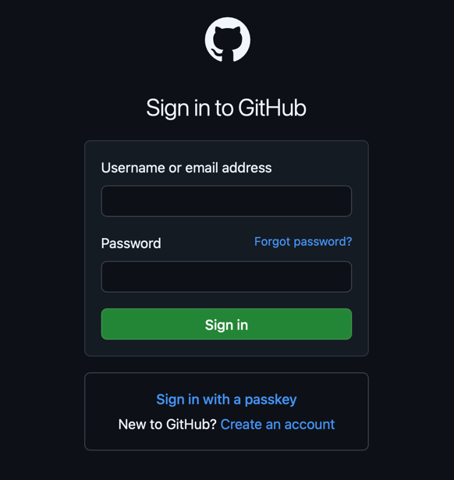
Getting started with GitHub:
Step 1. Sign in or Create an account on GitHub

Slide 5
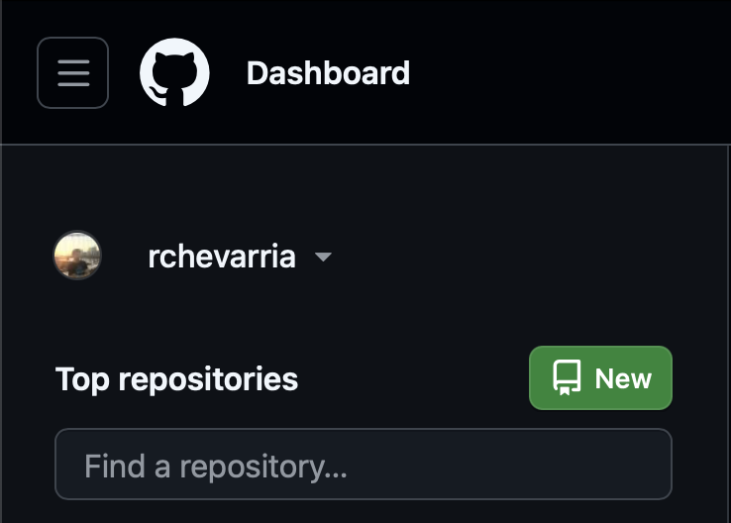
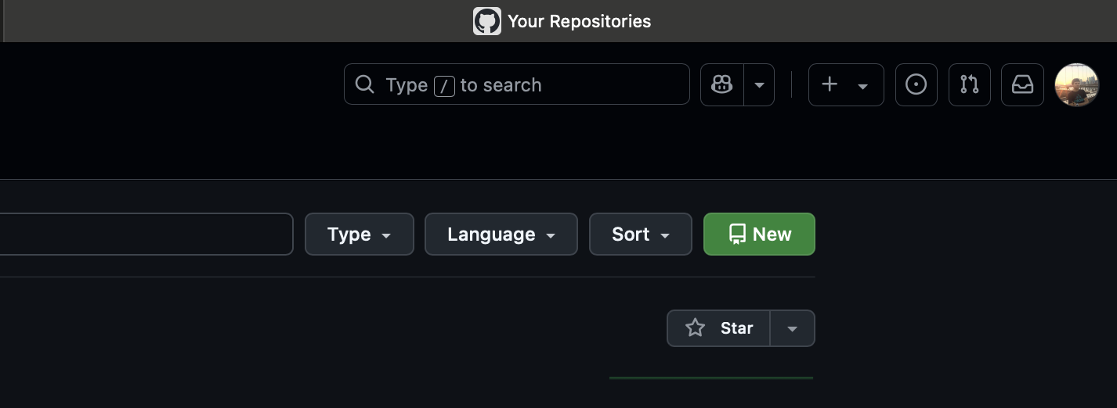
Getting started with GitHub:
Step 2. Create a new remote repository by clicking on ‘New’ either from the ‘Dashboard’ or from ‘Your Repositories’ tabs

Slide 6
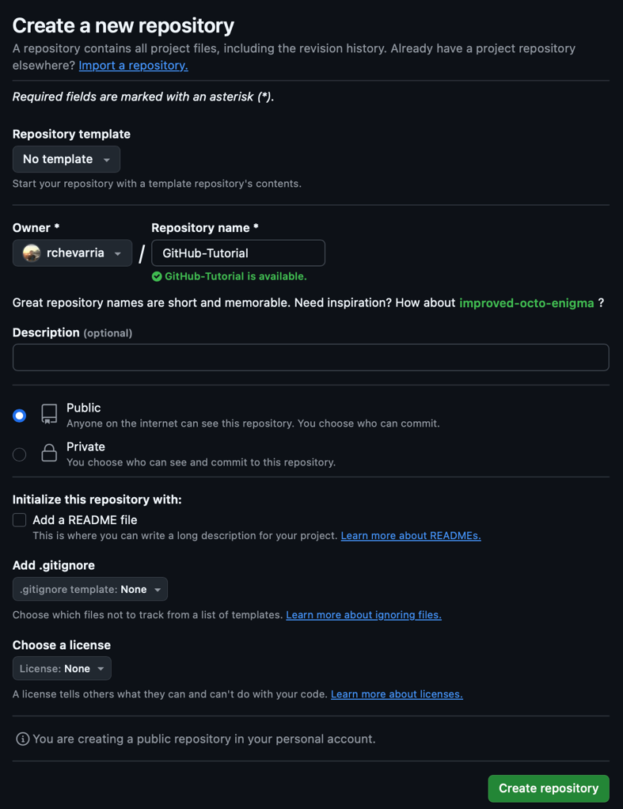
Getting started with GitHub:
Step 3. Naming your repository and setting its permissions.
You can think of repositories as folders that will contain your code/files, but additionally to being on your computer, it will also be on an online platform.
Make sure to name your repository something meaningful that describes your project.
Set the visibility- public repos can be found and accessed by anyone. Private repos can only be seen by you and any collaborators.
It is good practice to add a README file especially if it is a big project. Here you can include a well-formatted description of your project such as how other developers can run it, the project’s purpose, how users can utilize the project, etc.
Once finished, press ‘Create repository’

Slide 7
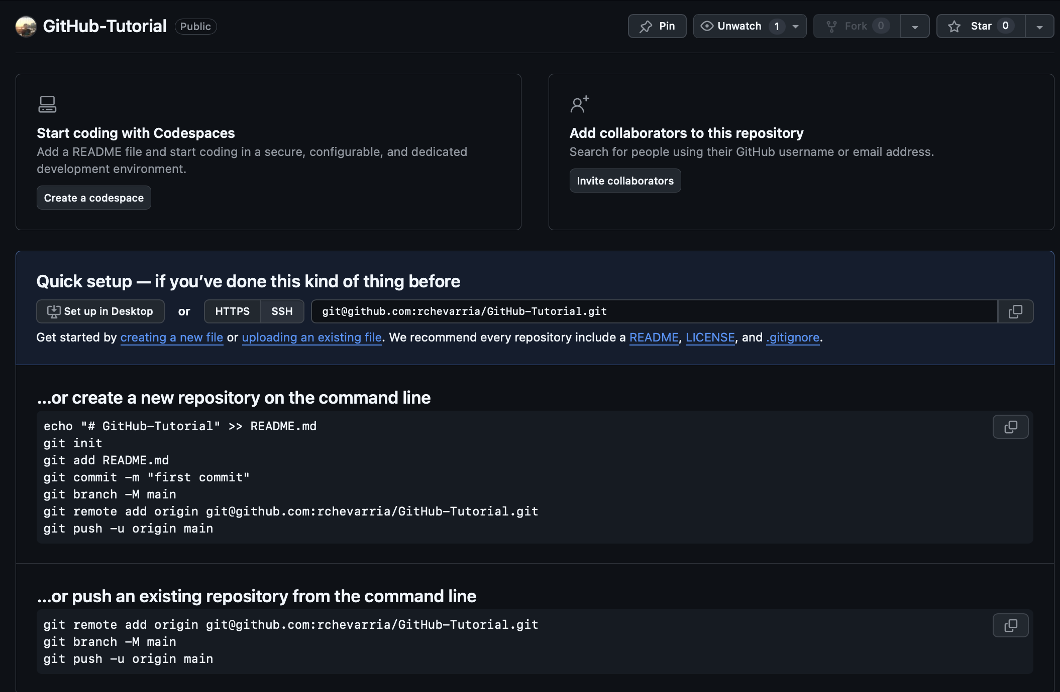
Getting started with GitHub:
Step 4. Connecting this remote repository to a local repository. (We should have SSH set up by now)
Here you have 3 options:
Option (1) You can clone this new empty repo locally, opening your terminal and in your desired directory and using the Git SSH remote URL:
git clone git@github.com:yourusername/my- new-repo.git
Option (2) Initializes a brand-new Git repo locally and then connects it to a remote repository on GitHub.
Option (3) Assumes a Git repo has already been initialized locally and contains some commits.
We will go over Option (1) in the next few slides

Slide 8
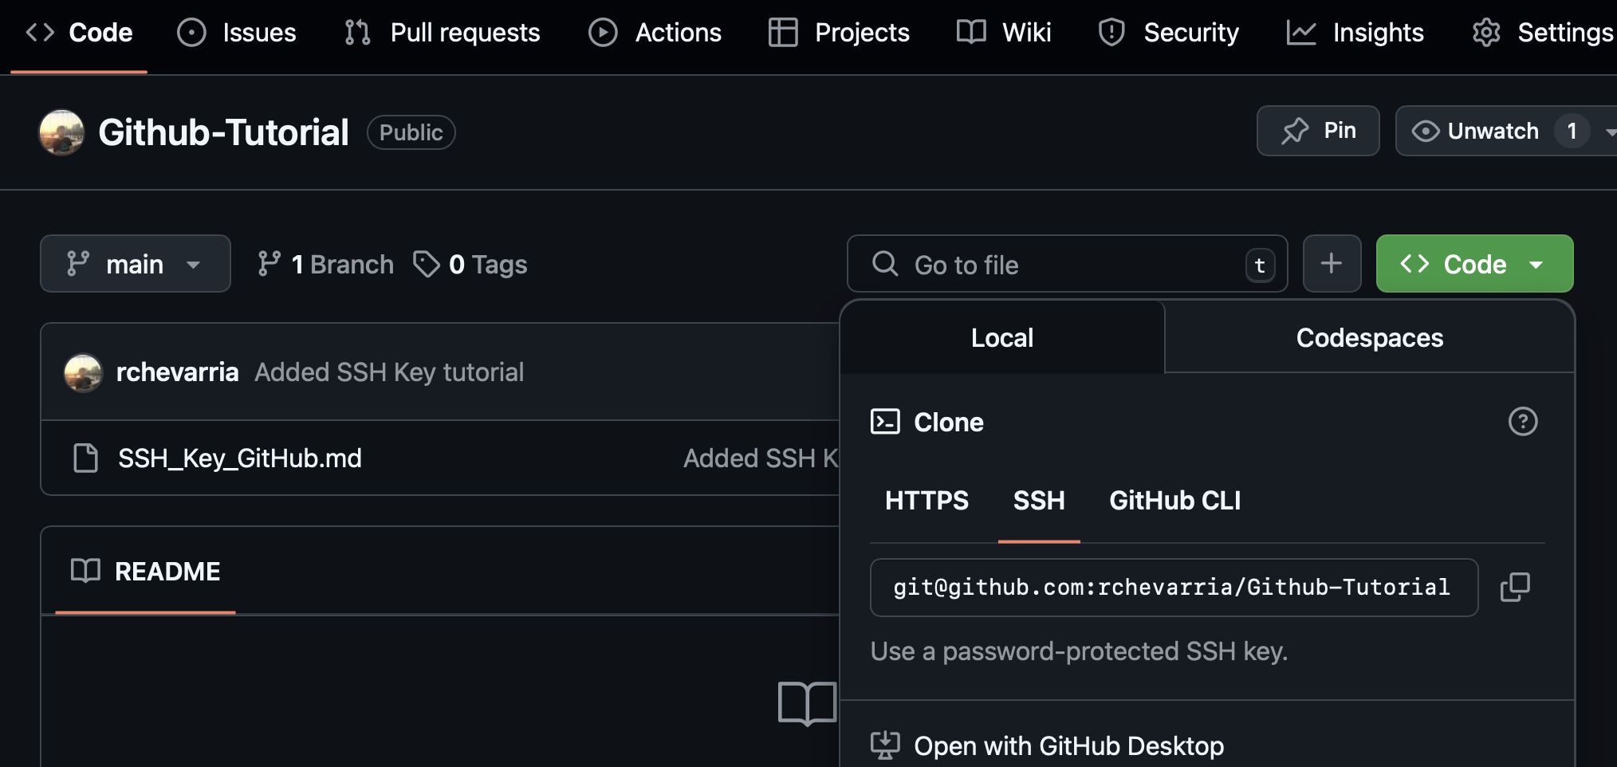
Getting started with GitHub:
Option 1: Cloning the repo
1. Copy the SSH Remote URL
or from the repo’s Code screen, press on the green ”Code” button → SSH → Copy the SSH Remote URL

Slide 9
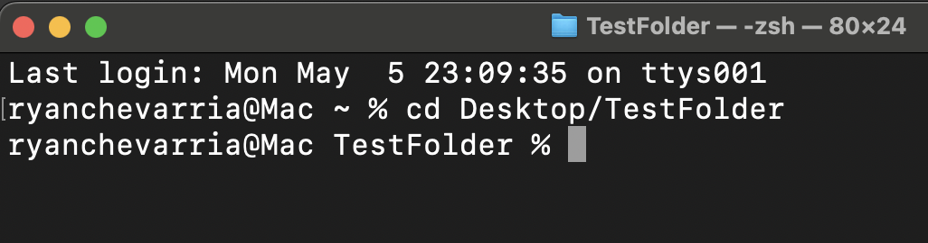
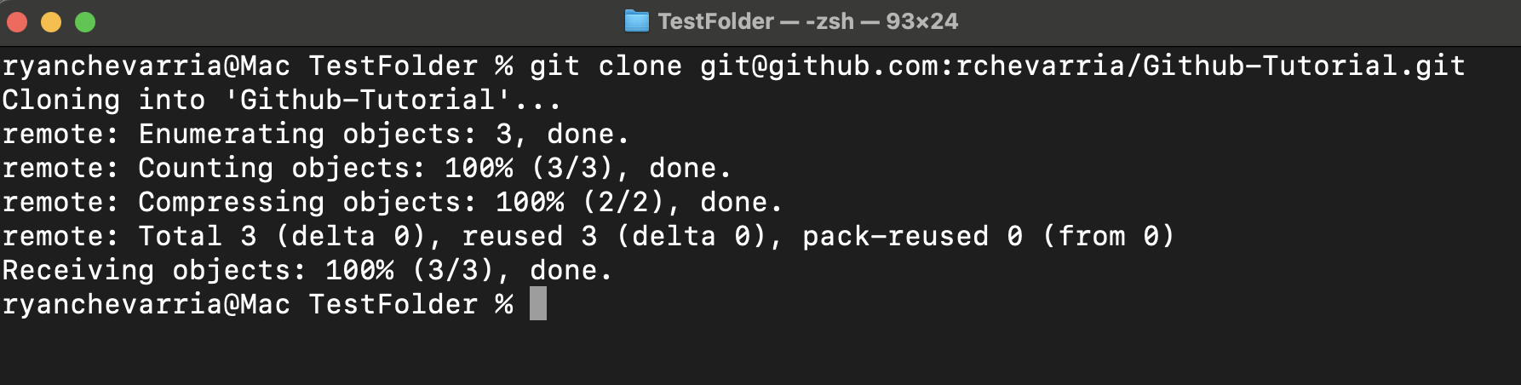
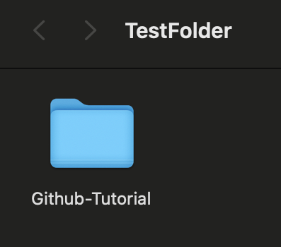
Getting started with GitHub:
Option 1: Cloning the repo
2. Open a Terminal window and change / switch to the directory to save this local copy of the repository. It will be cloned as a folder.
3. Type in git clone and your SSH remote URL (you copied in Step 1)

Slide 10
Getting started with GitHub:
At this point, your GitHub repository is now linked to the local folder on your computer. Any files you add or edit inside this folder can be tracked by Git and pushed to GitHub when you're ready.
Think of this folder as your local workspace that's synchronized with the remote repo on GitHub.
Version Control is now set up
and ready to use
✅

Slide 11
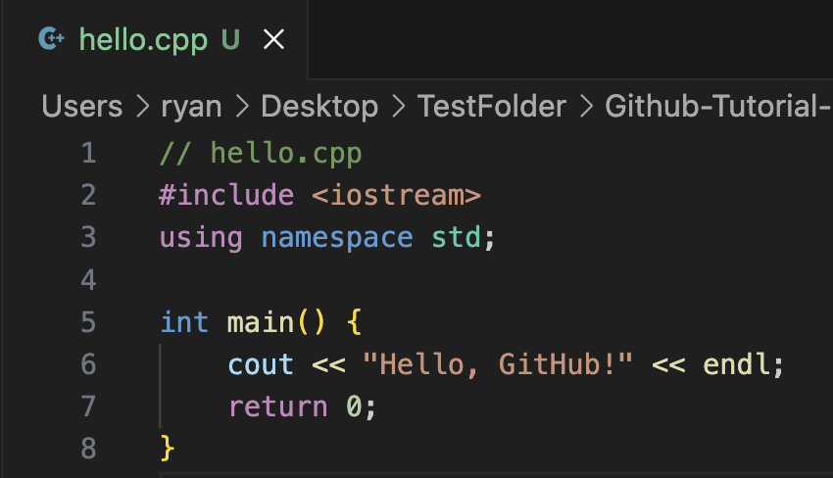
Getting started with GitHub:
Making Your First Commit – Working Locally: Making and Saving Changes
Track your changes with Git:
A good starting point would be to add/create your empty project files (.cpp, .hpp, .py, etc.) Change directories into your project folder / directory
Create project files either through the terminal or using your GUI / VSCode
In this case we will create a simple C++ program that prints “Hello, GitHub!” to the console

Slide 12
Getting started with GitHub:
Making Your First Commit – Working Locally: Making and Saving Changes
The first step is to add or stage your changes in your working directory (AKA telling GitHub what you would like to include in the next commit).
stage a specific file → git add filename1.extension filename2.extension
stage all non-hidden files → git add * stage all changes in the directory → git add .

Slide 13
Getting started with GitHub:
Making Your First Commit – Working Locally: Making and Saving Changes
The second step is to commit your changes, this takes everything we just added and records it into Git history. We must add a commit message that explains the changes, using the –m flag
Commit changes→ git commit –m “Added initial files”

Slide 14
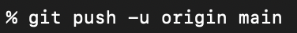

Getting started with GitHub:
Making Your First Commit – Working Locally: Making and Saving Changes
The third step, once changes are committed locally, we need to push them to your remote GitHub repository, so they’re backed up online, in sync and visible to you and/or your team
When pushing commits into a new repo for the first time, add the –u flag: ex. git push –u origin main (The –u flag links the local branch to a remote branch without needing to specify origin main every time)
Once you’ve pushed to the main branch with –u, you can just run git push from now on
Git remembers where to send your changes.

Slide 15
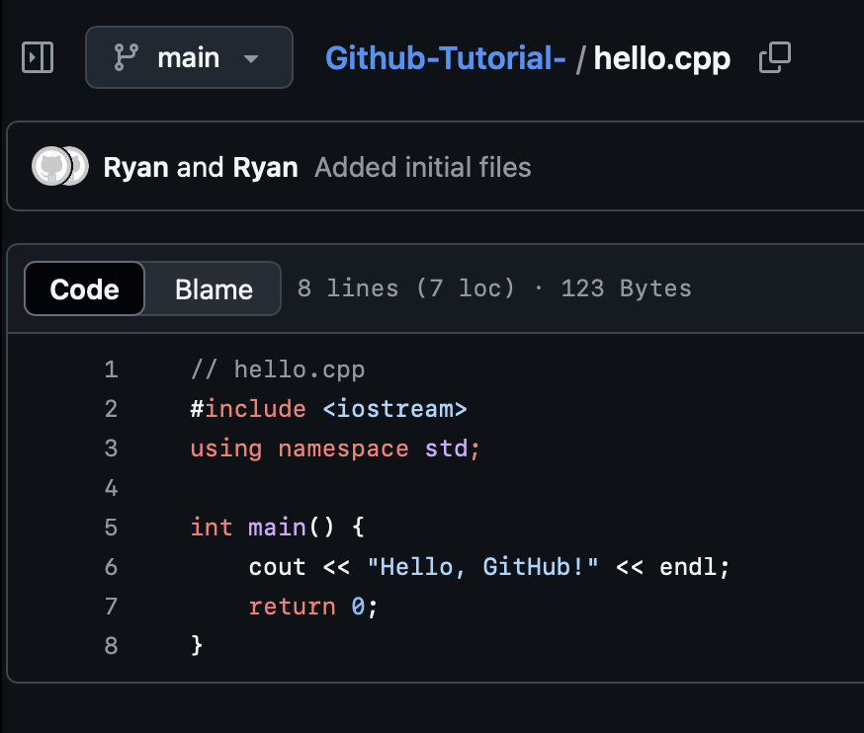
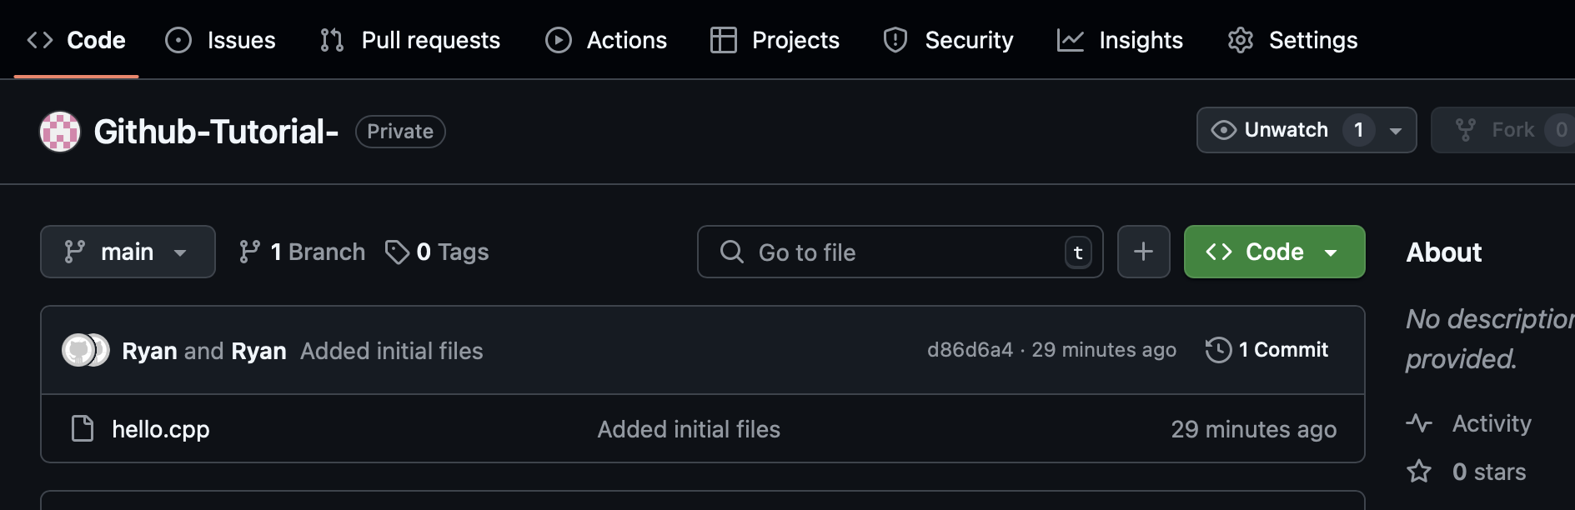
Getting started with GitHub:
Viewing Recent Changes pushed onto GitHub Remote Repo
Once pushed, you may go on GitHub, refresh your page and view the latest versions of your project.
From here, we can view full commit history, including who and when it was committed.

Slide 16
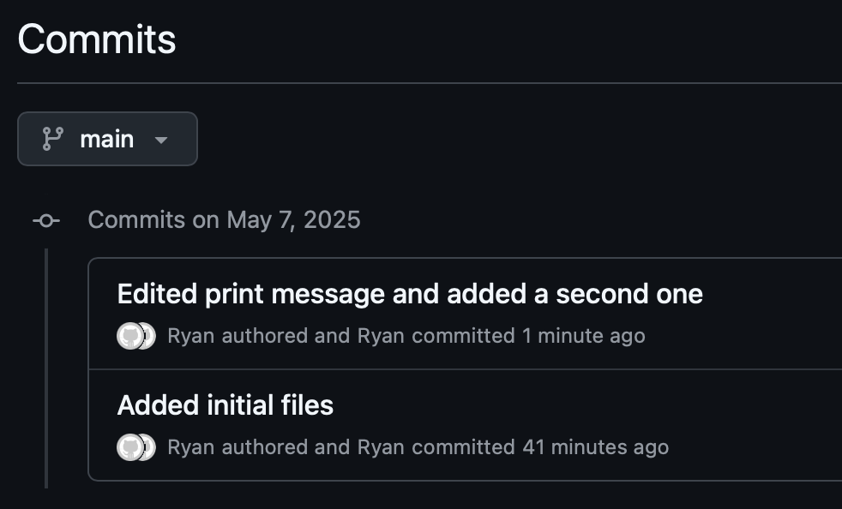

Getting started with GitHub:
Viewing Recent Changes pushed onto GitHub Remote Repo
We can also view exactly what the changes are between commits. (Let’s say we made changes to our hello.cpp file) and – add, commit, and push these changes to the main branch:
Now we have 2 commits in our history on our GitHub remote repo

Slide 17
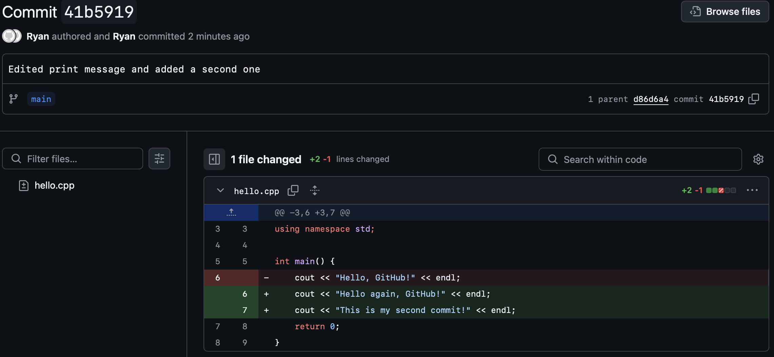
Getting started with GitHub:
Viewing Recent Changes pushed onto GitHub Remote Repo

Slide 18

Getting started with GitHub:
Reverting a previous commit
Git gives us several ways to undo previous commits. The safest way is to do a: revert - This creates a new commit that undoes the changes from a previous one.
- Ideal as nothing is deleted from the history and can be retrieved.
Use git log –oneline to show a condensed version of commit history and their commit hash
Revert the git hash you wish to undo: git revert <commit hash>

Slide 19
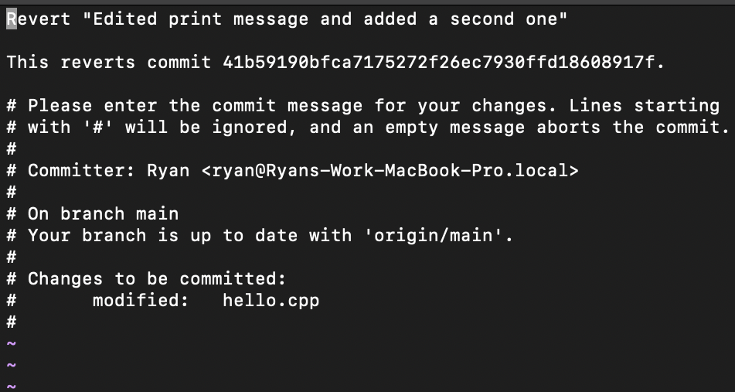
Getting started with GitHub:
Reverting a previous commit (Continued)…
After doing a git revert <commit hash> a vim default editor with a suggested message will appear. You can accept the default message or manually edit it in the editor
Default msg
To accept → Simply press the ‘esc’ button, and
:wq
this closes the vim editor
To edit the message → Press the ‘i’ key, this will allow you to edit the message, then press esc when finished and to close the editor
:wq
Must push changes to update GitHub Repo →

Slide 20
Getting started with GitHub:
Working with Branches: Safely Experimenting without Breaking Main
A branch is like a parallel version of your project. It allows you to work on new features or experiments without touching the main codebase (main branch)
What is a Branch?
lightweight, moveable pointer to a commit
Used to isolate work (add new features or fix bugs)
Why use branches?
Keep main branch clean and stable
Collaborate without stepping on each other’s work
Common branch names?
feature/login-form
bugfix/typo-in-readme
dev or test

Slide 21
Getting started with GitHub:
Working with Branches: Safely Experimenting without Breaking Main
Create and Switch to a new branch: git checkout –b nameOfBranch
flag -b creates the branch
checkout switches to it
Make your changes using add and commit
Push the branch to GitHub:
Since it is the first time, we must use the –u flag again
e.g. git push –u origin new-feature In this example now you are working in the branch called new-feature, all changes
are isolated from the main branch until you merge them later.
*Recommendation: For efficiency - create a branch for individual features or bugs. Following a reasonable number of commits, consider merging into main function. (If working in a group, discuss with team or project owner before merging branches into main.

Slide 22
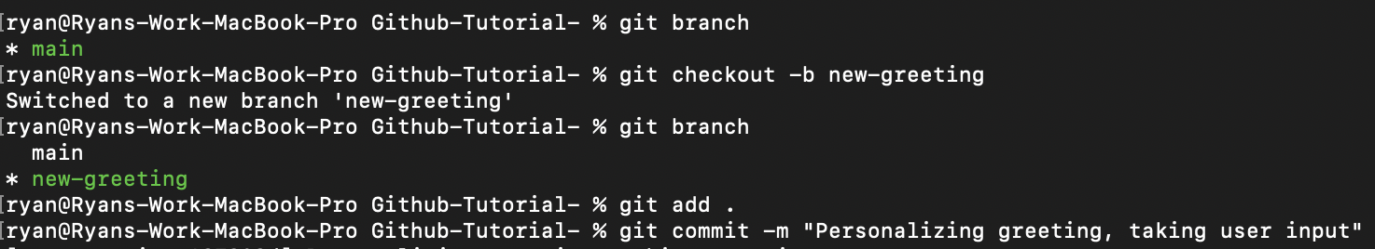
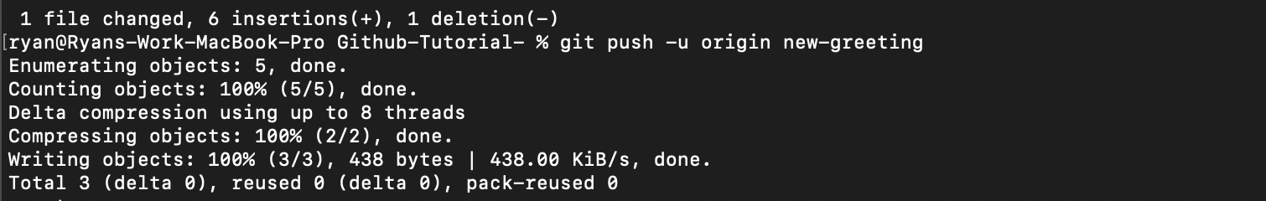
Getting started with GitHub:
Working with Branches: Safely Experimenting without Breaking Main
Sample workflow using branches:

Slide 23
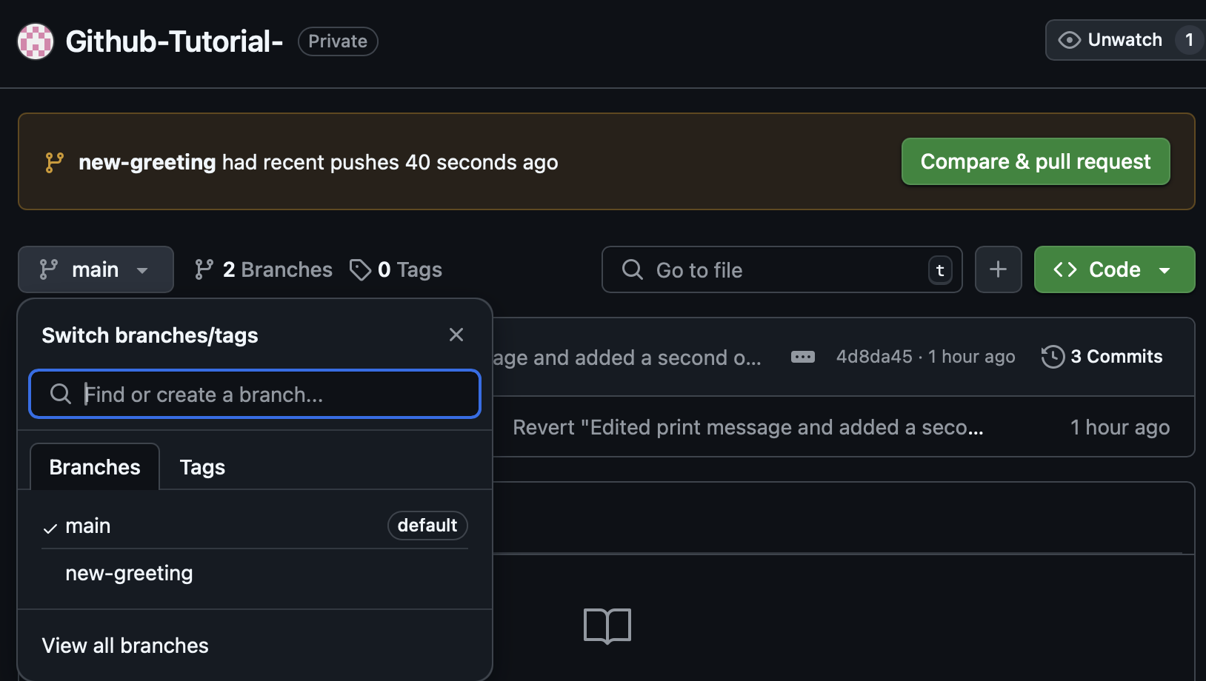
Getting started with GitHub:
Working with Branches: Safely Experimenting without Breaking Main
Sample workflow using branches:
As soon as you push / set up the upstream for this new branch it will appear on your GitHub Remote Repo
You may switch between branches remotely through the drop-down menu, and locally with git checkout

Slide 24
Getting started with GitHub:
Working with Branches: Safely Experimenting without Breaking Main
Sample workflow using branches:
Pull Request / Merges
A pull request is a way to ask “Can we bring the changes from this branch into another one (usually main)

Slide 25
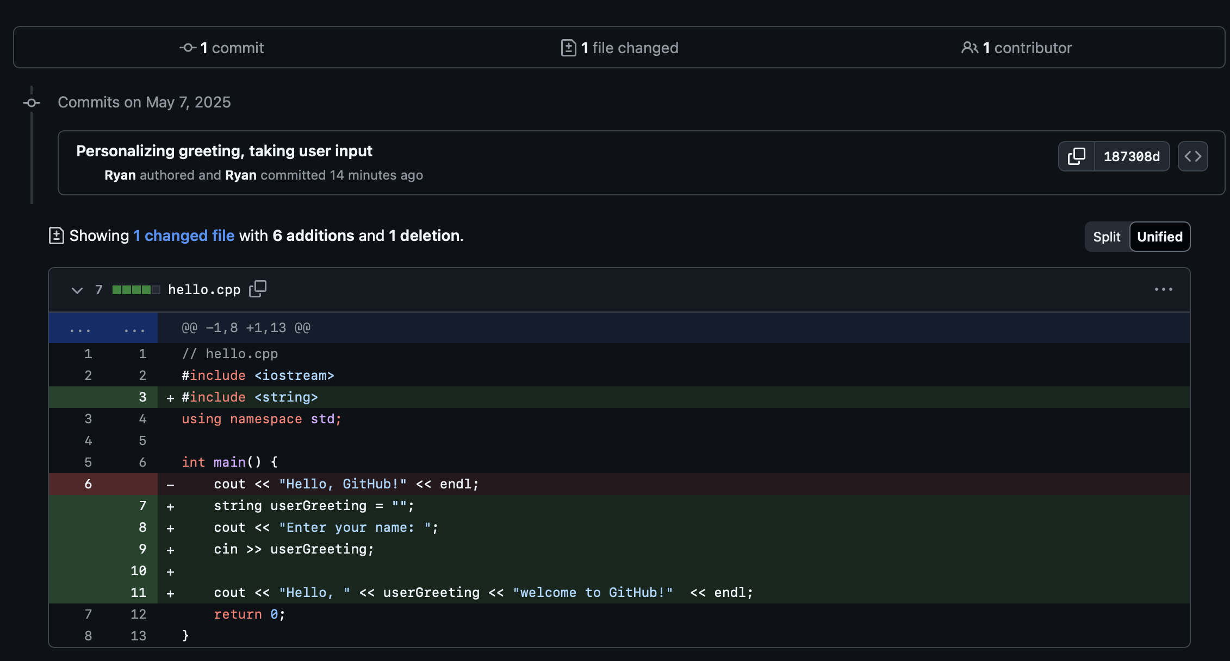
Getting started with GitHub:
Working with Branches: Safely Experimenting without Breaking Main
Sample workflow using branches:
Pull Request / Merges
You may add a description of your changes and if you scroll to the bottom you will be able to review changes between the two merging branches.

Slide 26
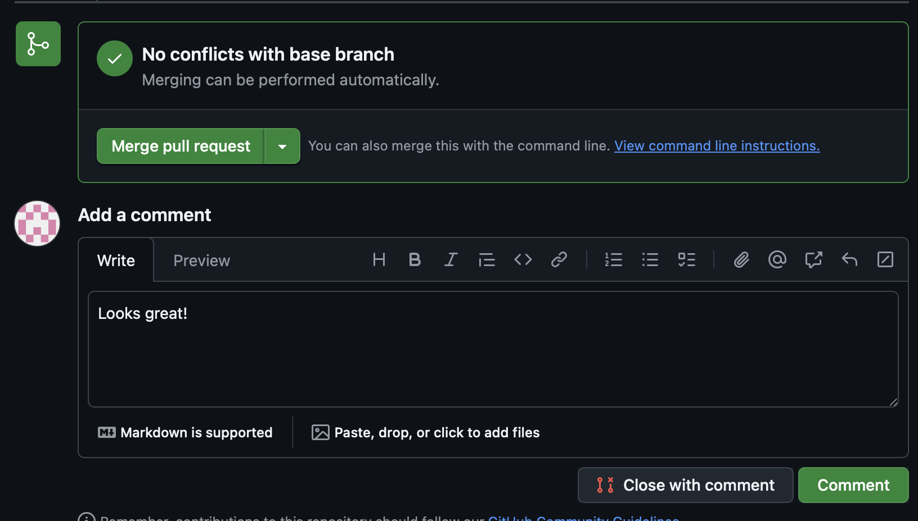
Getting started with GitHub:
Working with Branches: Safely Experimenting without Breaking Main
Merging
Pull Request / Merges
Once the pull request is created, depending on project settings, the project/Repo owner can merge the pull request

Slide 27
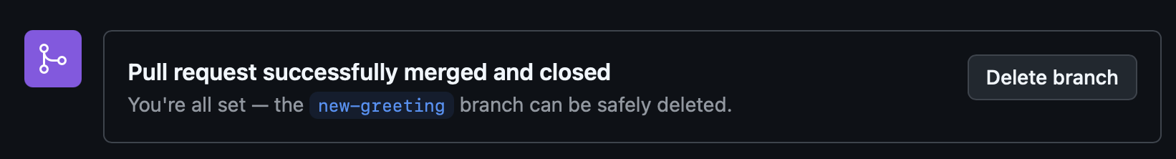
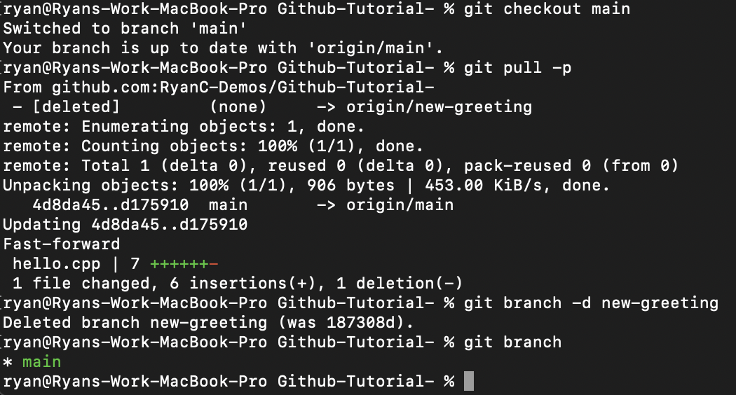
Getting started with GitHub:
Working with Branches: Safely Experimenting without Breaking Main
Merging
Pull Request / Merges
After the pull request is merged, you may safely delete the feature branch.
switch to main
Locally, checkout to the main branch, PULL the changes from the remote main branch which is currently the most
up-to-date at this point.
pull changes from remote
Delete branch

Slide 28
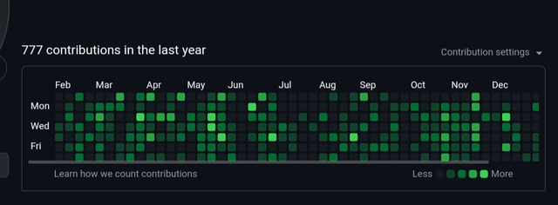
Getting started with GitHub:
GitHub is more than just a code storage tool
It’s a platform for:
Version control and collaboration
Safely experimenting with branches
Submitting and reviewing code changes
Tracking your progress and history
GitHub profile is a public portfolio:
Shows employers your projects, activity, and contributions
Demonstrates real-world development practices
Each push is a receipt of what you’ve built

